Slide 1

Solving the 1D Heat Equation in MATLAB

Slide 2
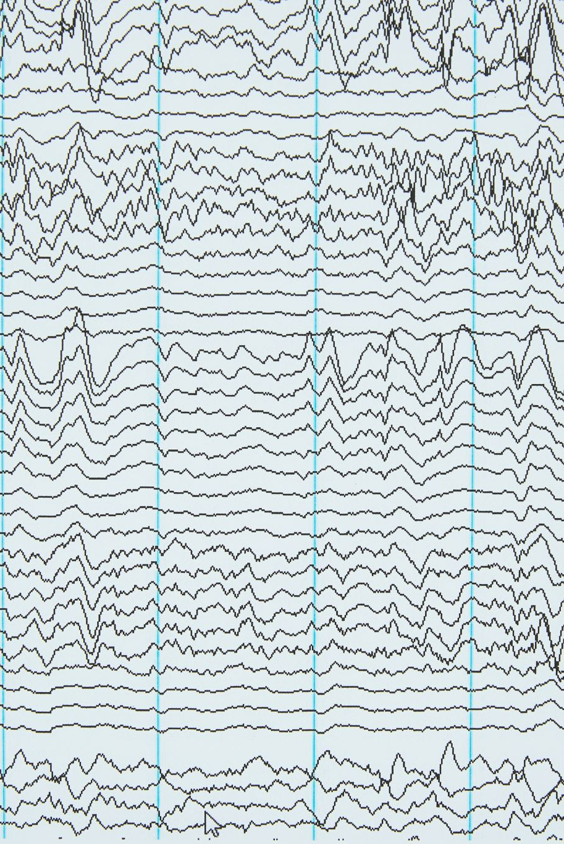
Introduction
We solve how temperature spreads in a metal rod over time.
This is based on the 1D heat equation, a partial differential equation (PDE).
We use MATLAB to compute an approximate solution using finite differences.
We visualize the temperature change in 2D and 3D plots.

Slide 3
What is the Heat Equation?
The equation: ∂u/∂t = c · ∂²u/∂x²
u(x, t): temperature at position x and time t
c: material constant (how fast heat spreads)
Boundary: u(0,t) = u(L,t) = 0 (rod ends stay at 0°C)
Initial condition: u(x,0) = f(x), the starting temperature

Slide 4
Numerical Solution – Finite Difference Method
We use a grid with M points in space and N in time.
dx = L / (M-1), dt = T / (N-1)
We approximate the heat equation with this formula:
U(m,n+1) = U(m,n) + r * (U(m+1,n) - 2*U(m,n) + U(m-1,n))
Where r = c * dt / dx² (must be ≤ 0.5 for stability)

Slide 5
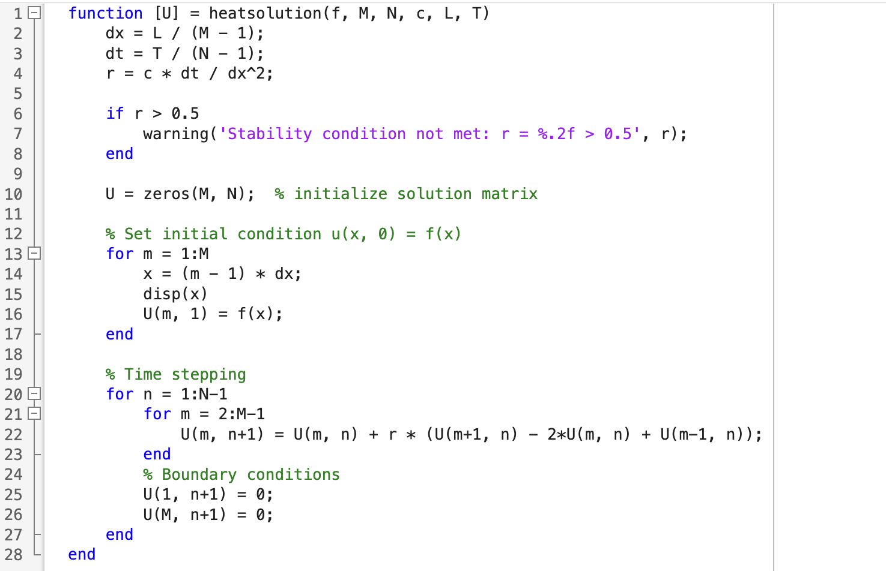
Task 1 Code

Slide 6
MATLAB Function: heatsolution.m
Inputs: f (initial temp), M, N, c, L, T
Initializes grid and time step values
Applies finite difference formula in a loop
Handles boundary conditions (u=0 at rod ends)
Outputs matrix U: temperature at each space and time step

Slide 7
Important Variables
f(x): Initial temperature (e.g. sin(x))
M: number of spatial points
N: number of time points
L: length of rod, T: total time
c: material constant, usually 1
dx, dt: step sizes in space and time
r: stability ratio = c * dt / dx²

Slide 8
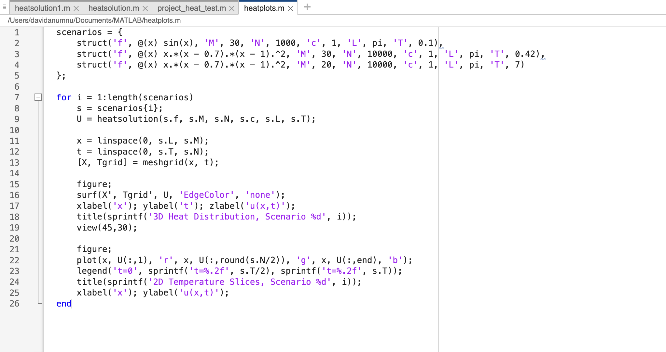
Task 2 Code

Slide 9
MATLAB Script: heatplots.m
Runs three test cases with different f(x) and T
Each case simulates heat flow using heatsolution.m
Plots 3D surface: u(x,t) over time and space
Plots 2D slices: temperature at t = 0, mid, and end

Slide 10
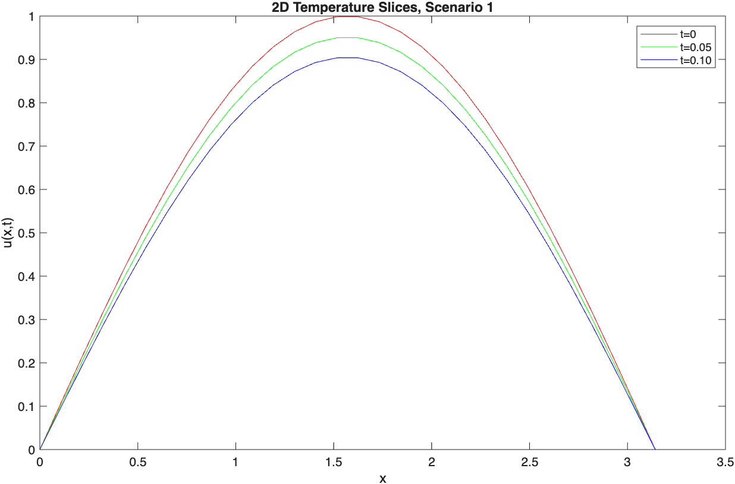
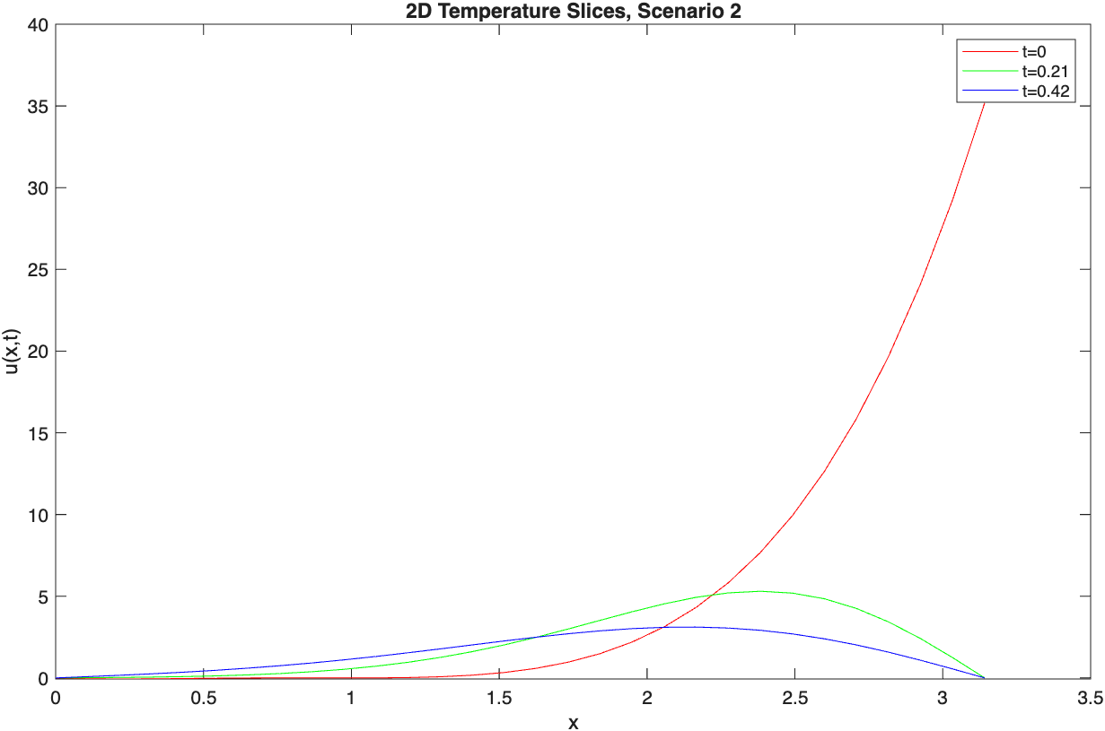
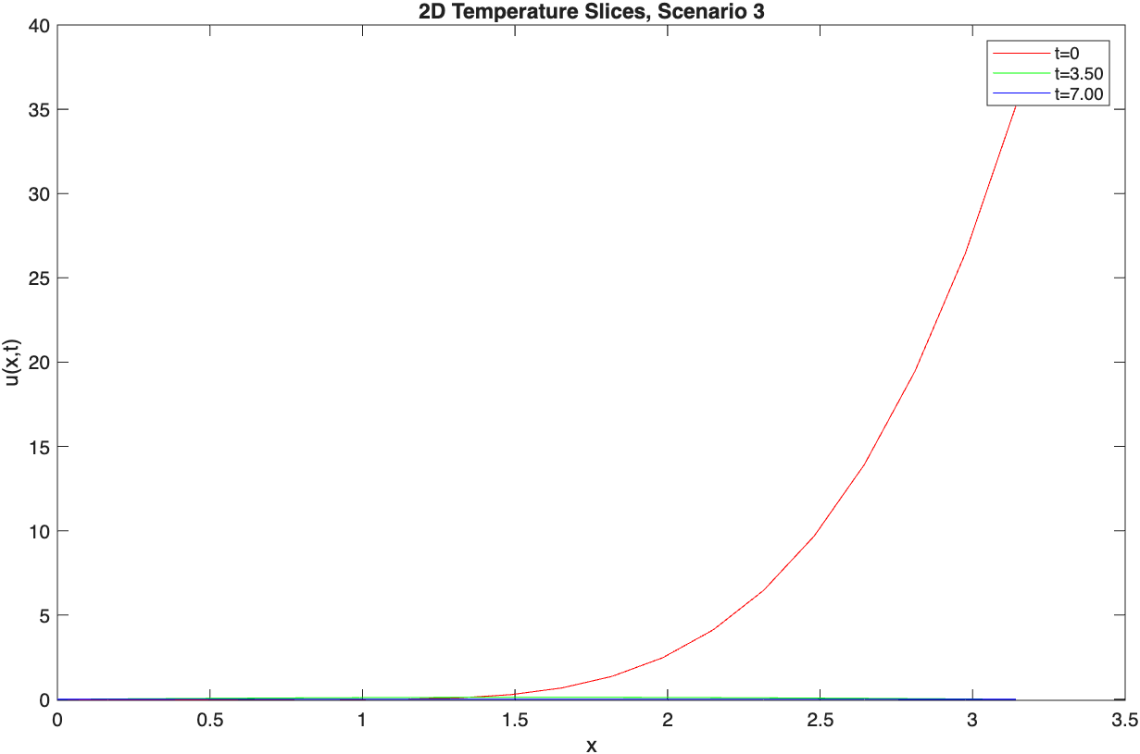
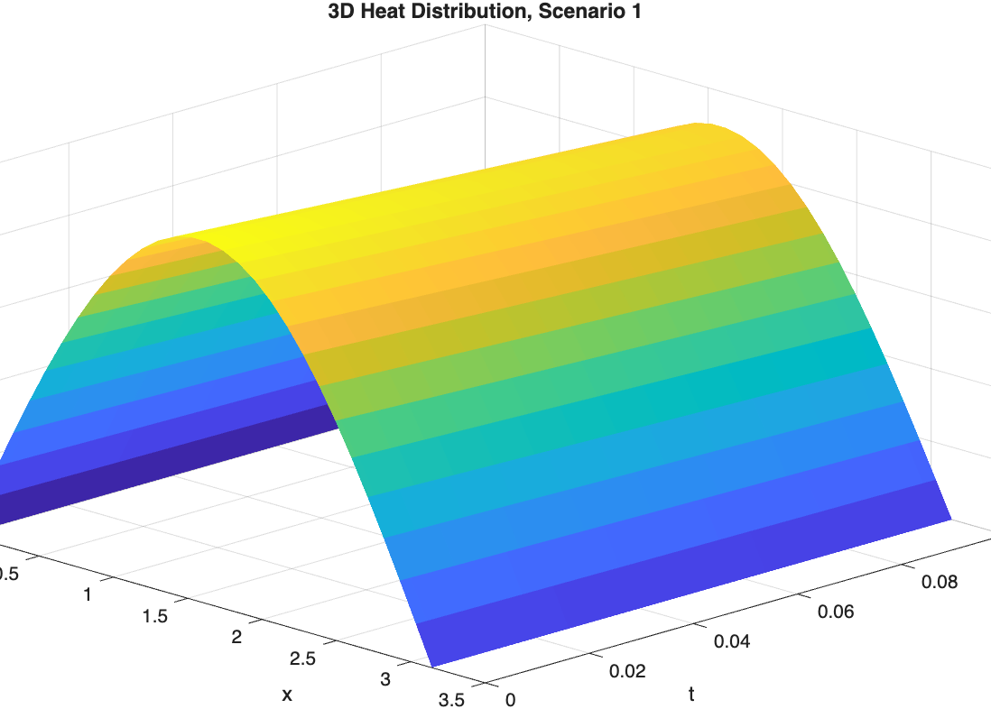
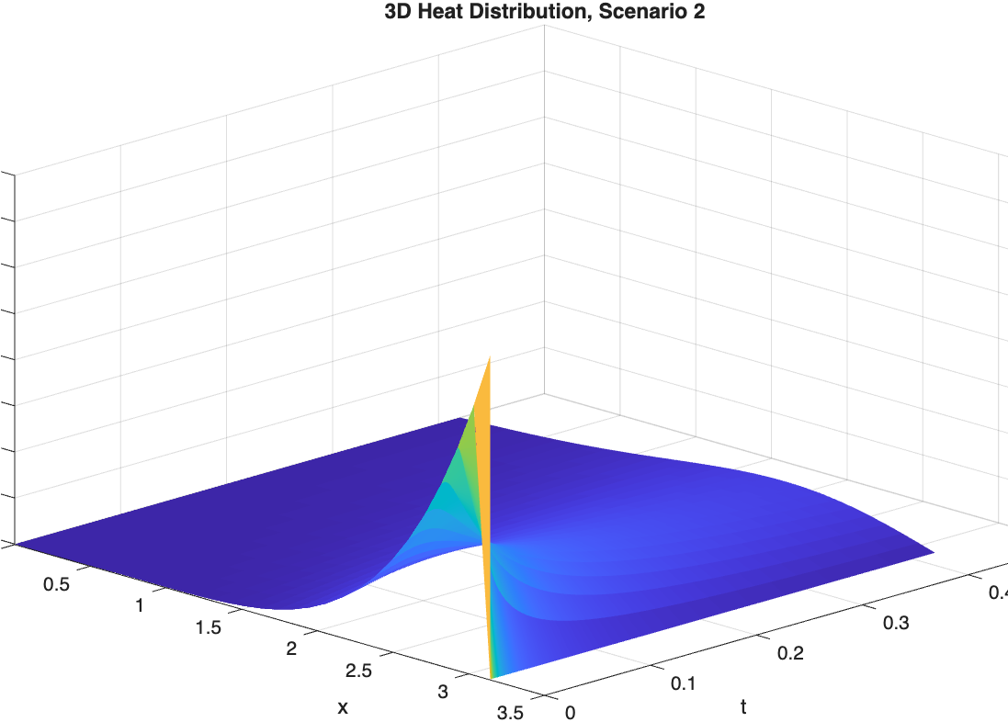
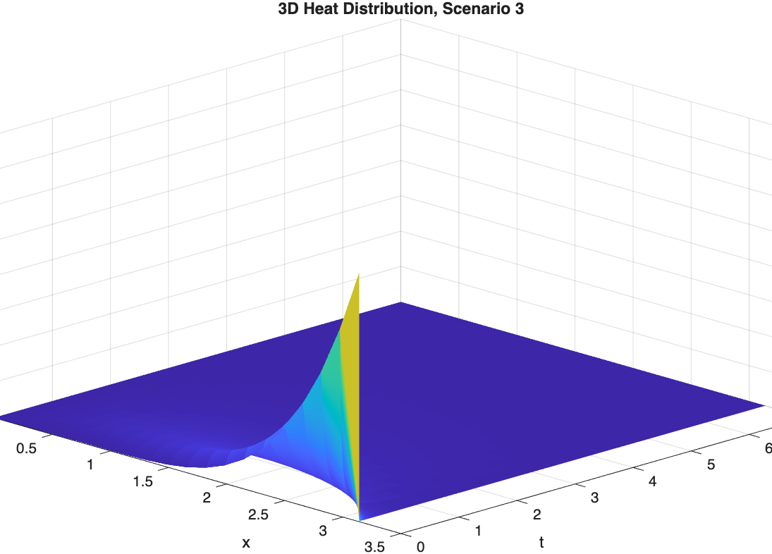
Heat plots 2D and 3D

Slide 11
Test Cases
Case 1: f(x) = sin(x), T = 0.1
Case 2: f(x) = x(x−0.7)(x−1)², T = 0.42
Case 3: same f(x), T = 7
*Each shows how heat smooths over time from initial shape

Slide 12
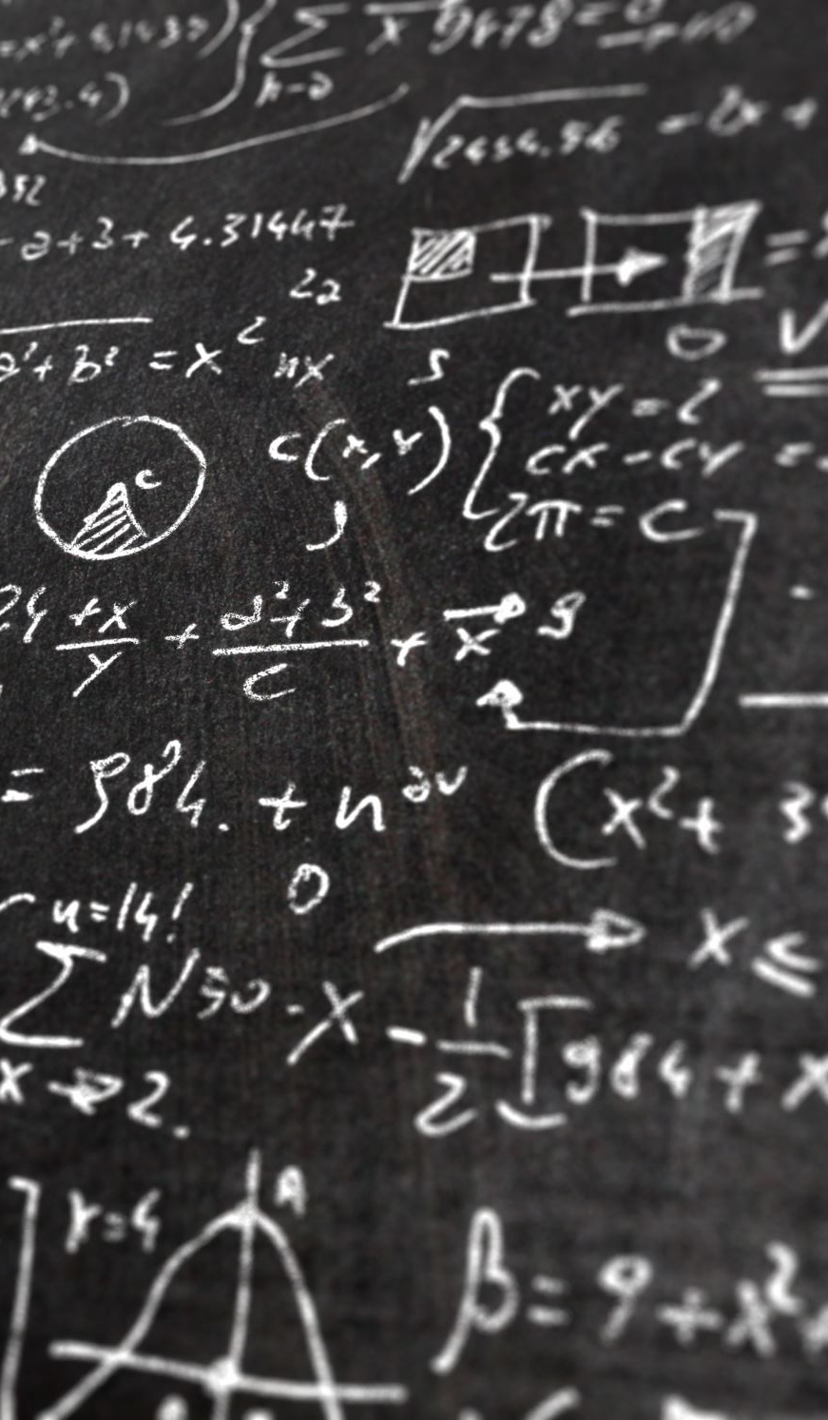
What We Learned
How to model physical systems using code.
Understanding and applying the heat equation.
Finite difference method and stability rules.
Writing functions and scripts in MATLAB.
Visualizing results in 2D and 3D.

Slide 13
Sources of information
https://www.3blue1brown.com/lessons/heat-equation
https://chat.openai.com
https://uk.mathworks.com/help/?s_tid=mlh_sn_help
https://www.mathworks.com/help/matlab/math/solve-system-of-pdes.html
https://uk.mathworks.com/help/matlab/ref/struct.html
*We used MATLAB documentation, a video by 3Blue1Brown, and got some help from ChatGPT to fix minor code bugs and language phrasing.

Slide 14

Thanks for your attention!

